Slide 1


DS 5110 - Project Presentation - Spring’22 - Group 8 Farhan Chughtai | Sai Vineeth Kaza | Nithya Balachandiran | Pratyusha Parashar
Taiwan Company Bankruptcy Prediction

Slide 2
Importance of Bankruptcy Prediction
Identifying Bankrupt Enterprises will reduce the risk to investors.
Inaccuracy in bankruptcy forecasting can negatively impact finance and leads to a devastating blow to business owners, partners, society and the entire national economy.
Establishing a reliable enterprise failure prediction model is critical to the company

Slide 3
Goals of Bankruptcy Prediction
Find key features in predicting bankruptcy.
Visualize interesting patterns in the data.
Predict bankruptcy effectively and find best performing model.

Slide 4
Data
The dataset has 6819 observations
Numerical Variables - 93
Categorical Variables - 2
Target Variable - Bankrupt?
We do not have any null or empty values in the Dataset.
Data tidying is not required.

Slide 5
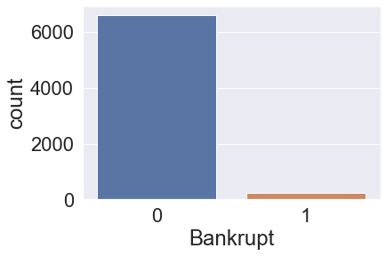
EDA shows imbalanced data
Techniques used to handle imbalanced data
Smote
Oversampling

Slide 6
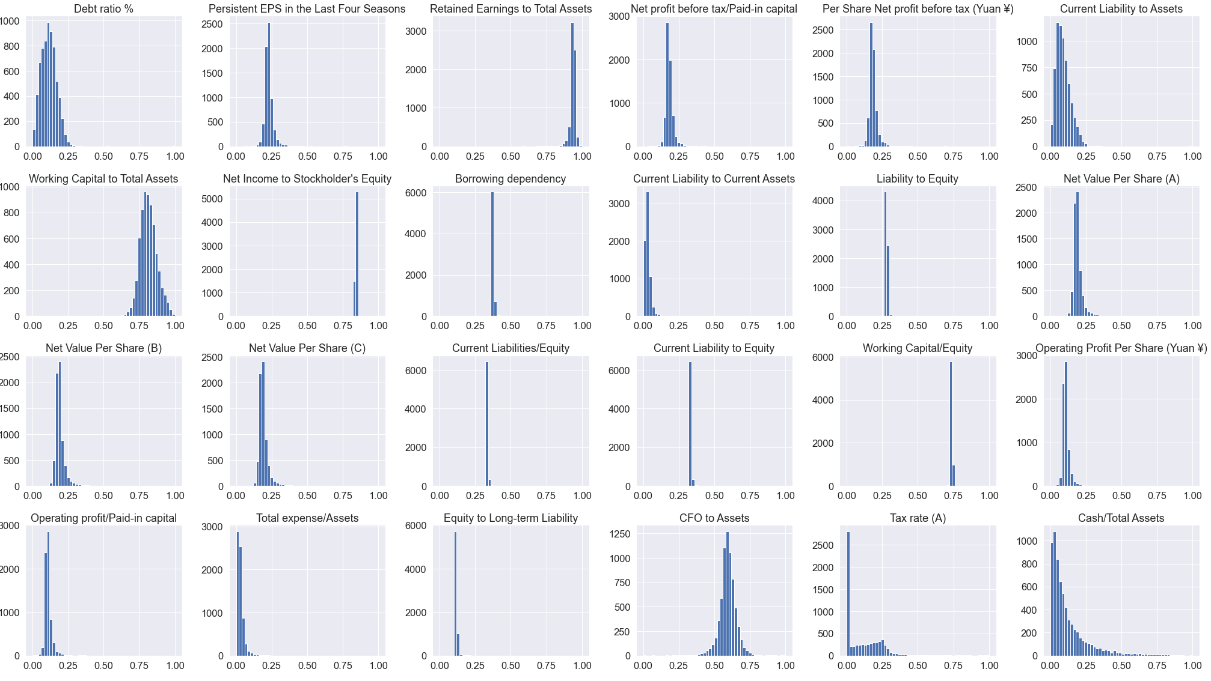
Distribution of Variables

Slide 7
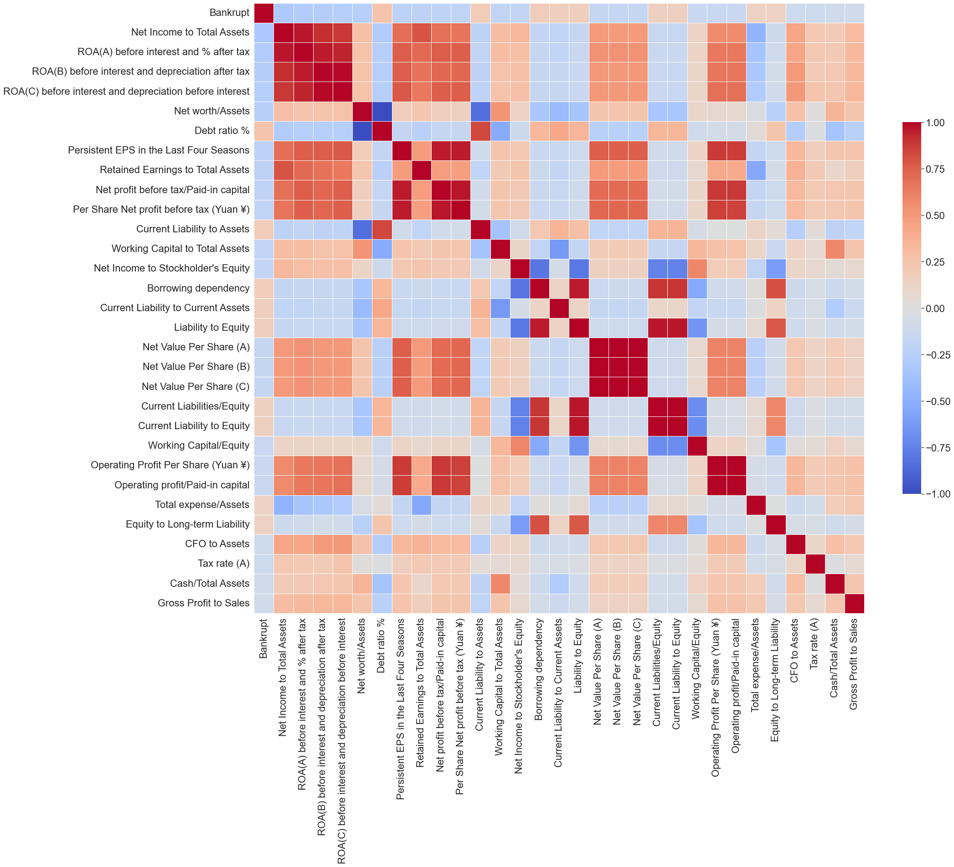
EDA - Top 30 correlated predictors – Heat Map

Slide 8
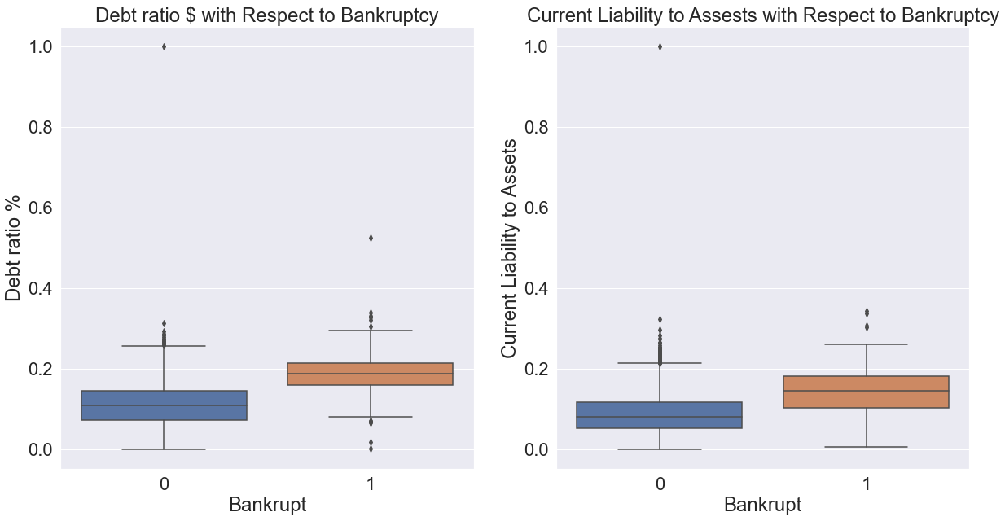
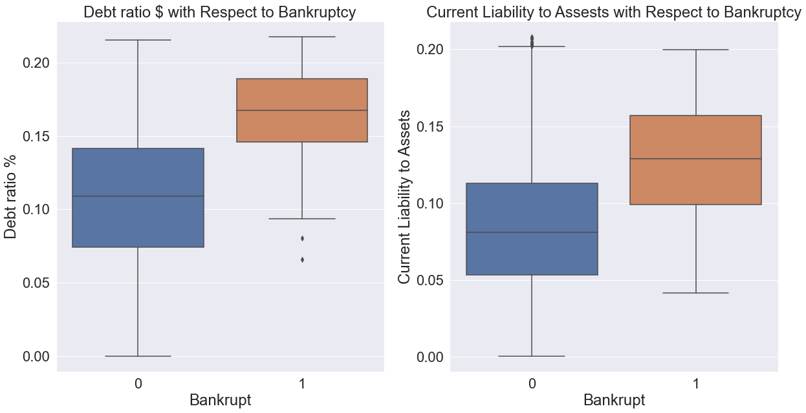
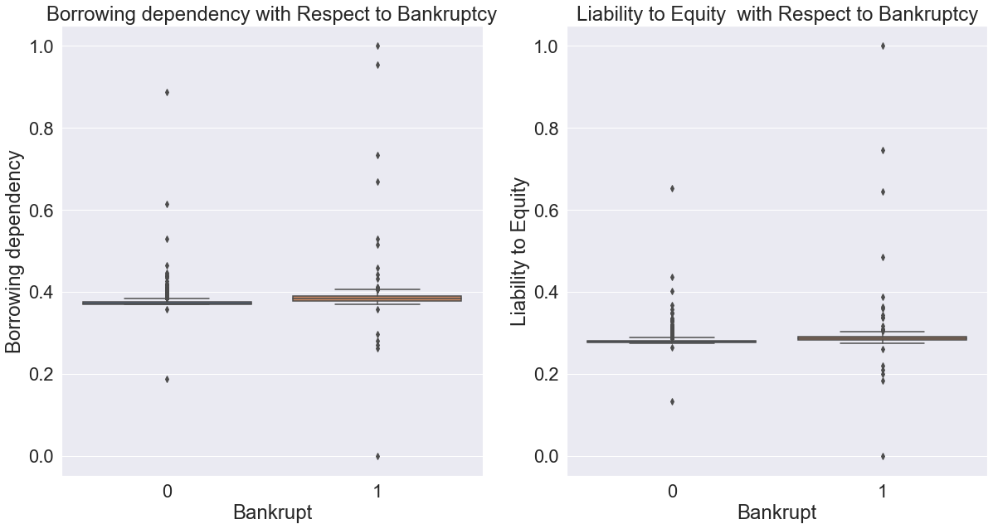
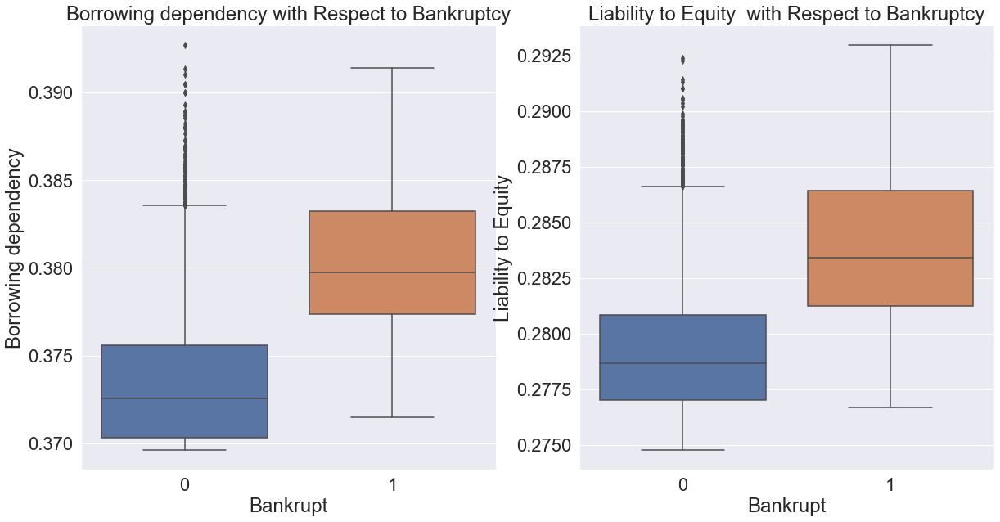
EDA – Predictors with positive correlation With Outliers and Outliers Removed

Slide 9
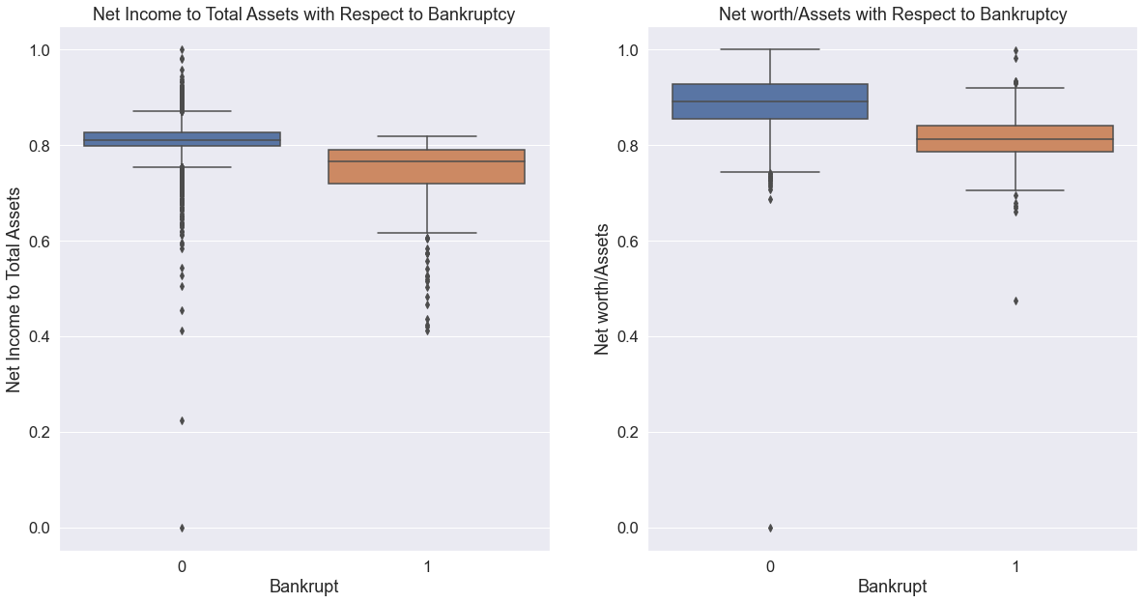
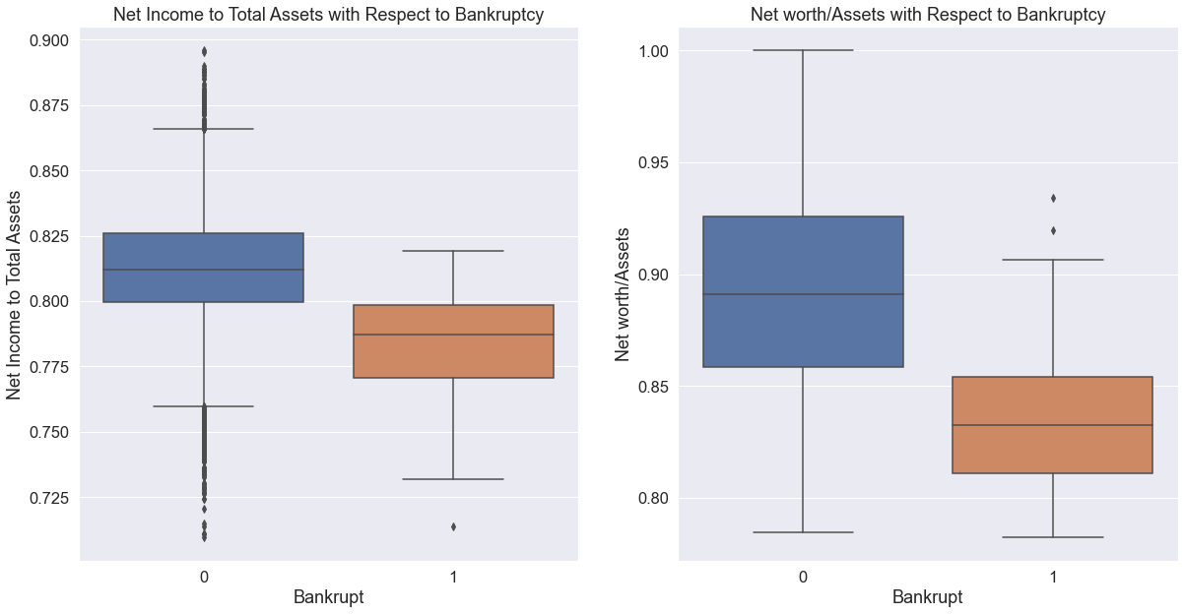
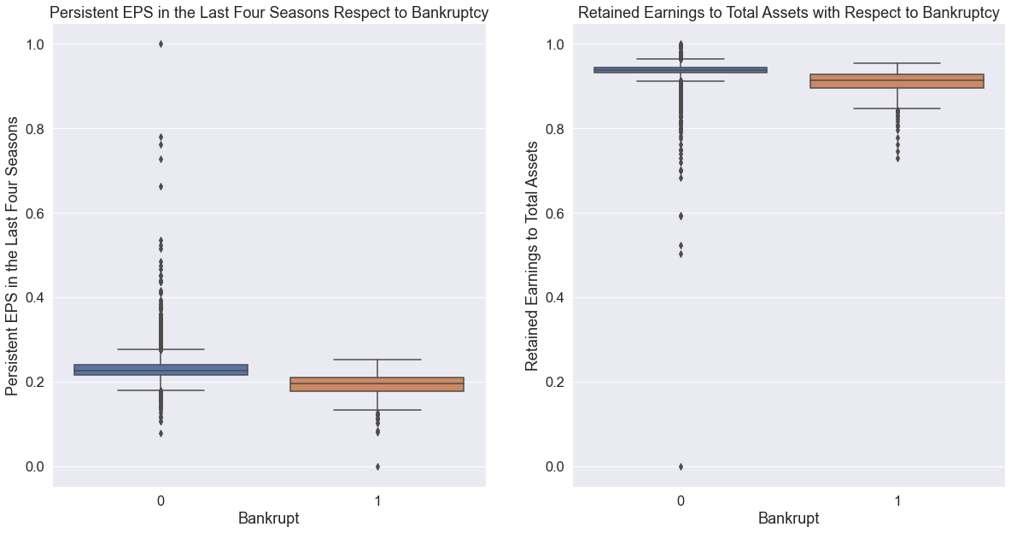
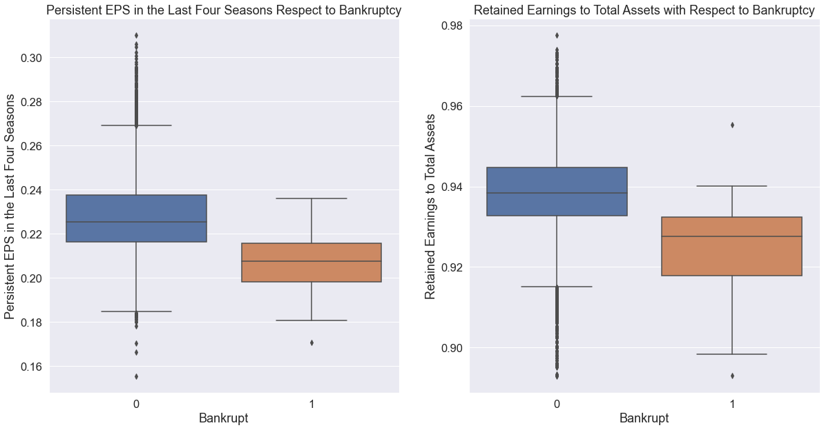
EDA – Predictors with negative correlation With Outliers and Outliers Removed

Slide 10
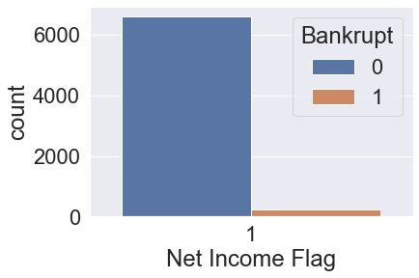
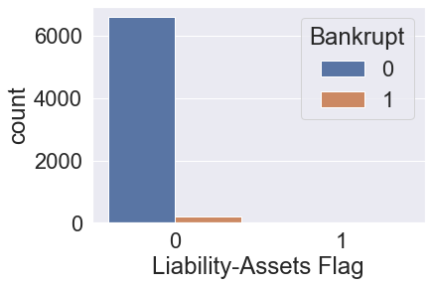
EDA – Categorical Variables
Net Income Flag
Liability-Assets Flag
Liability-Assets Flag 1
Bankrupt | 6
Non Bankrupt | 2
Net Income Flag is 1 for all the observations.
It can’t be used as a predictor.
Liability-Assets Flag 1 associates with
many bankrupt companies.
It can be used as a predictor.

Slide 11
Feature Selection
Data Transformation
Cross Validation
Best Parameters
Model Training
Evaluation On Validation set
Best Models
Final Evaluation Test Data
Machine Learning Process Flow

Slide 12
Feature Selection
Predictors with less than 0.1 correlation with the target variable were removed.
After initial Cutoff Only 30 predictors were left out of initial 95 predictors.
Predictors with more than 0.8 correlation among the independent variables were removed.
Finally, we were left with 14 predictors.

Slide 13
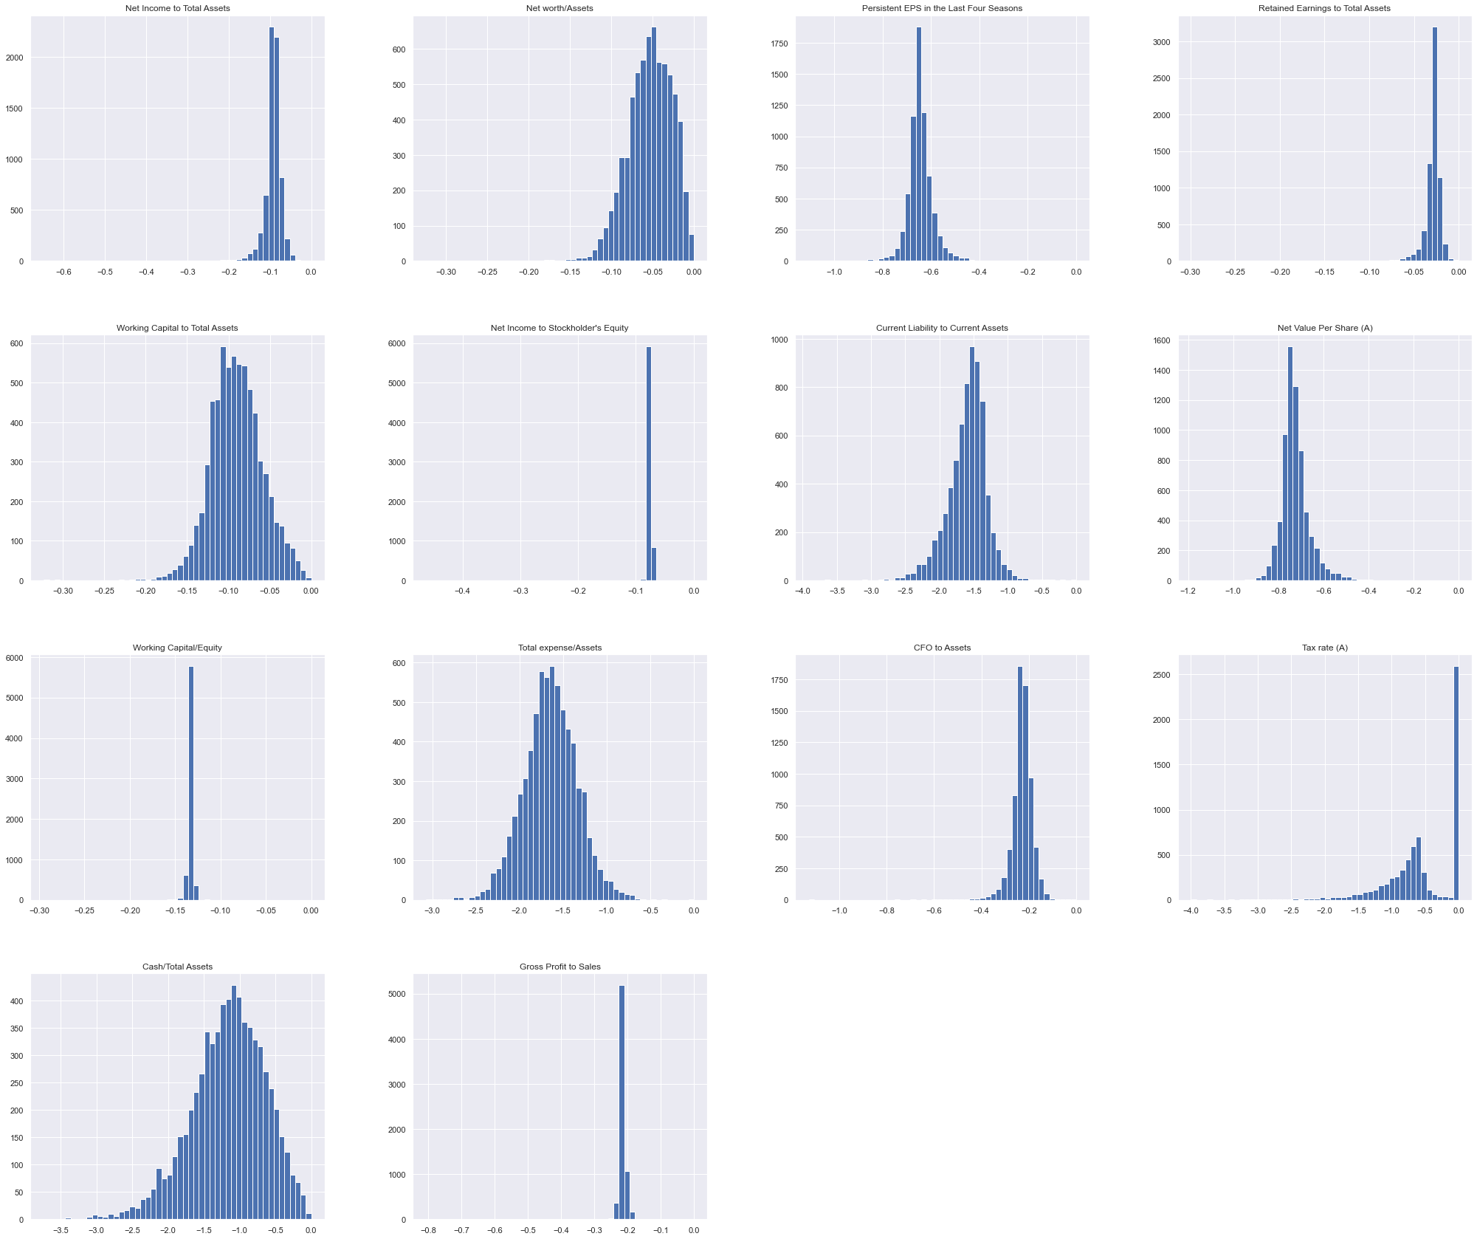
Data Transformation (Log10)

Slide 14
Data Scaling
We used a standard scaler z = (x - u) / s.
Only training data was used by the scaler to transform the dataset.

Slide 15
Train , Validation and Test Data Preparation
We did initial split of 90/10 to get training and test data.
Another split of 70/30 was performed on the training data to get the validation data and final training data.

Slide 16
Modeling Techniques
Logistic Regression
K-Nearest Neighbors
Linear Discriminant Analysis (LDA)
Quadratic Discriminant Analysis (QDA)
Support Vector Classifier (SVC )
Random Forest
Cat Boost
XG Boost

Slide 17
Models Results on Validation Set
Over Sampling
Smote
Models | Precision | Recall | F1-Score | Precision | Recall | F1-Score
XG Boost | 0.35 | 0.43 | 0.38 | 0.25 | 0.54 | 0.34
Random Forest Classifier | 0.27 | 0.57 | 0.37 | 0.30 | 0.54 | 0.38
Cat Boost | 0.35 | 0.40 | 0.37 | 0.19 | 0.77 | 0.31
K Nearest Nieghbours | 0.30 | 0.29 | 0.29 | 0.20 | 0.43 | 0.27
Quadratic Discriminant Analysis QDA | 0.18 | 0.83 | 0.29 | 0.17 | 0.86 | 0.29
Logistic Regression | 0.15 | 0.91 | 0.26 | 0.15 | 0.91 | 0.26
Linear Discriminant Analysis LDA | 0.14 | 0.91 | 0.24 | 0.14 | 0.91 | 0.24
Support Vector Classifier | 0.15 | 0.71 | 0.24 | 0.16 | 0.66 | 0.26

Slide 18
Hyper Parameters Used for Each Model After CV
Models | Hyper Parameters
Logistic Regression | C=1, solver='liblinear'
K Nearest Neighbors | n_neighbors=2
Linear Discriminant Analysis | solver=‘SVD’
Quadratic Discriminant Analysis | reg_param=1.0, store_covariance=True
Random Forest Classifier | N_estimators=100,criterion=‘gini’,
Support Vector Classifier | C=10, probability=True
Cat Boost | 'eval_metric': 'F1’, verbose’: 0, 'learning_rate': 0.1, 'iterations': 100
XG Boost | booster=‘gbtree’, eval_metric='logloss’, max_depth=9, alpha=0.5

Slide 19
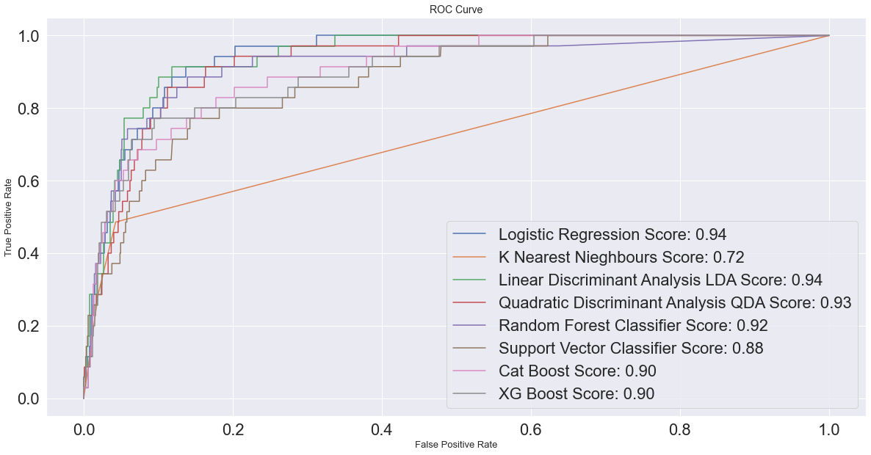

Slide 20
Best Model Selection
Over Sampling technique produced better over all F1-score for some of our models as compared to SMOTE.
Logistic regression for it’s recall value and Random Forest Model for the best over all precision to recall ratio are the best models.
Recall is the most important metric for selecting the best models.

Slide 21
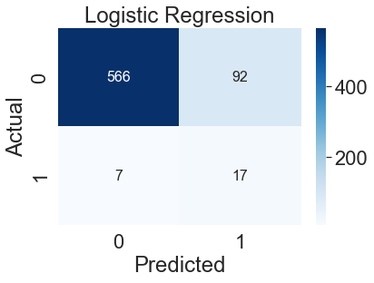
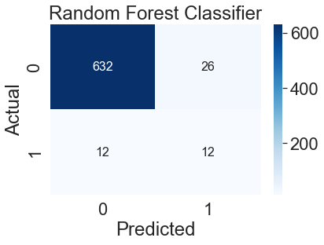
Final Results on Test Data
Model | Precision | Recall | F1-Score | F1-Score(Weighted Avg)
Logistic Regression | 0.16 | 0.71 | 0.26 | 0.90
Model | Precision | Recall | F1-Score | F1Score(Weighted Avg)
Random Forest | 0.32 | 0.50 | 0.39 | 0.95

Slide 22
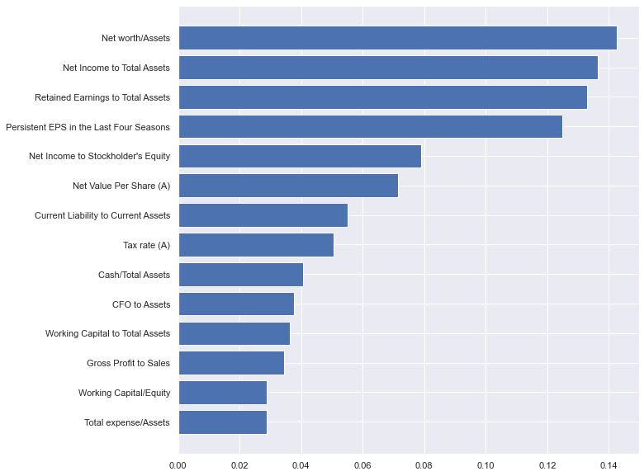
Feature Importance Random Forest Model

Slide 23
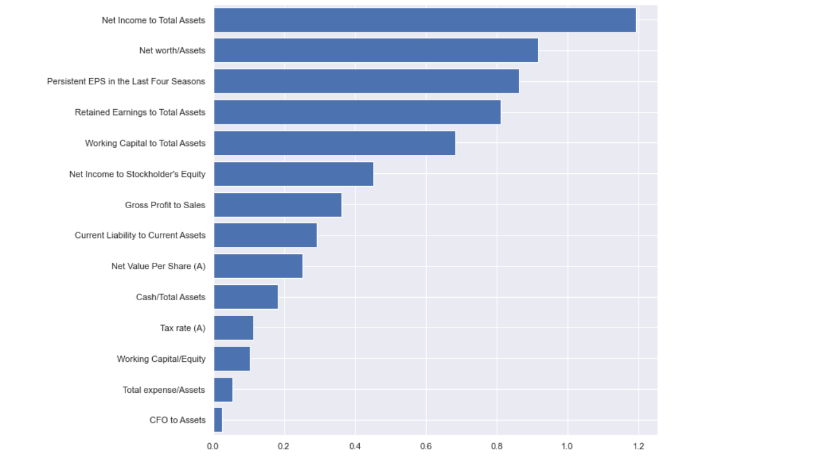
Feature Importance Logistic Regression

Slide 24
Summary
Recall is the main metric for bankruptcy predictions.
Modeling with 14 predictors performed better than modeling on full dataset, indicates that model with all the predictors was overfitting.
Log transformation and Scaling were performed together as that was giving better results than only applying log transformation.
Our dataset represents a real world scenario where a generic model like logistic regression out performs boosting algorithms in predicting bankruptcy.

Slide 25
THE END

